Slide 1
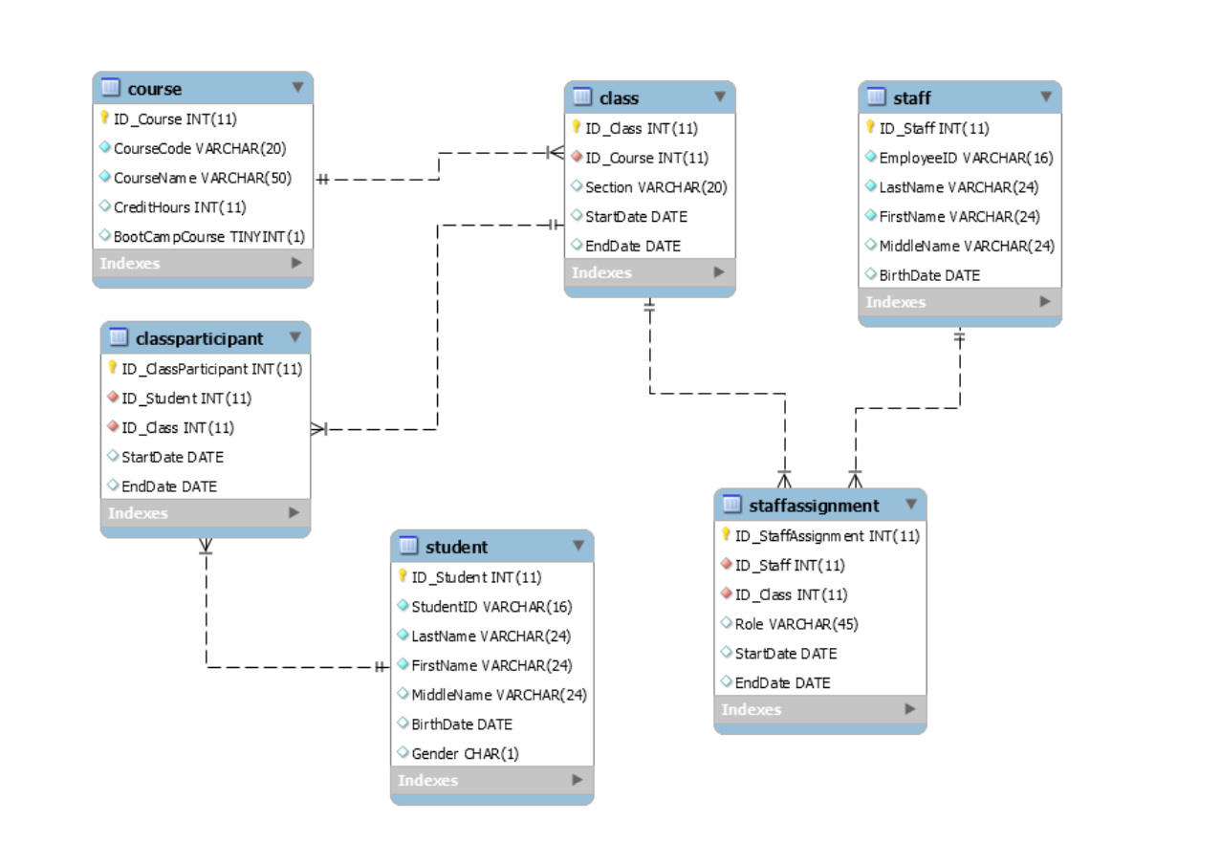
1
4
2
M
M
M
C
My SQL Schema
6
C
C
5
3
M
C
C

Slide 2
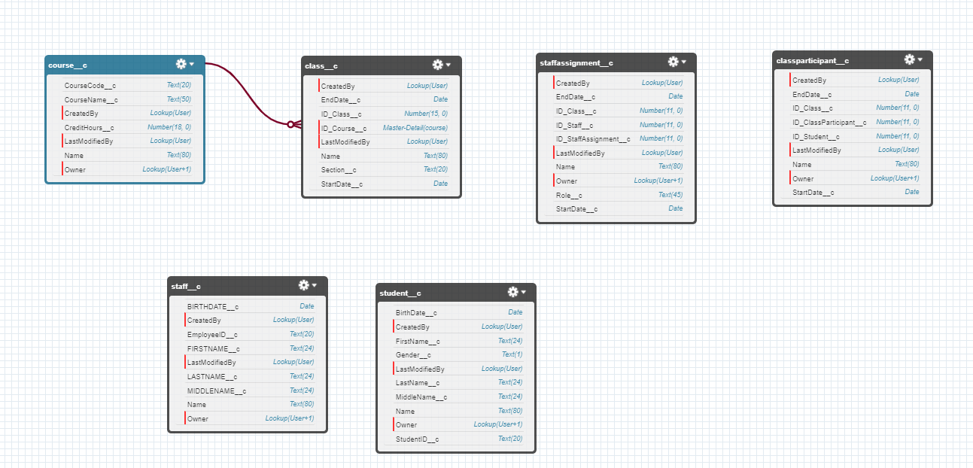
Salesforce
Name is the Primary Key for the course table
The ID_Course__ column here is the foreign key field which references course__c(Name)
Master – M
Child -C

Slide 3
Pull Master Data from MySQL (AWS)
Data Transformations
Load to Salesforce. Get the

Slide 4
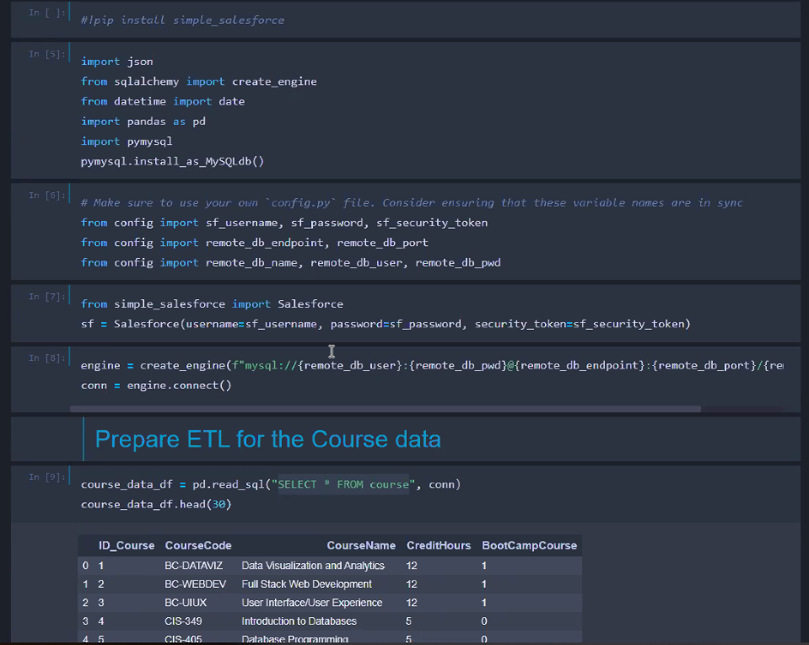

Slide 8
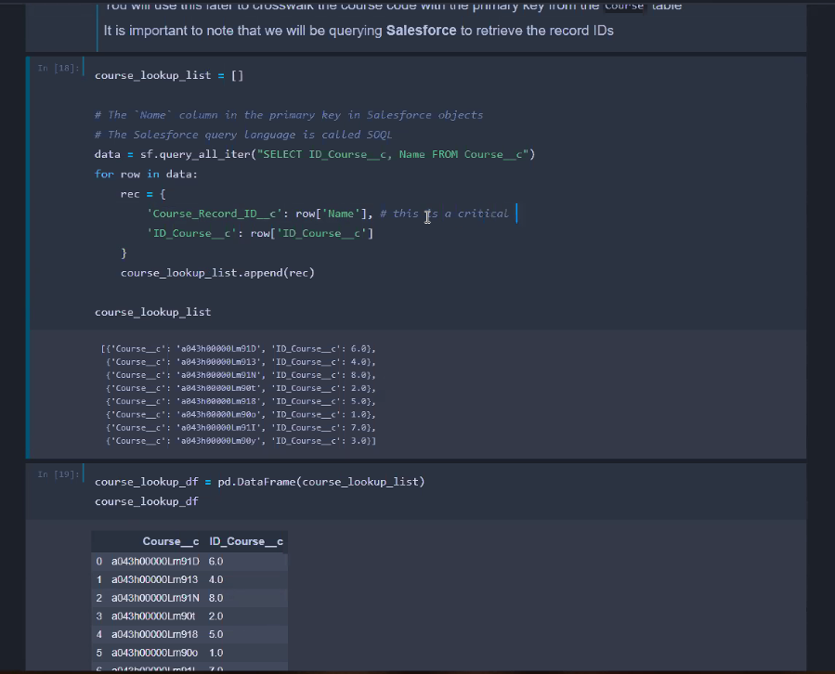

Slide 9
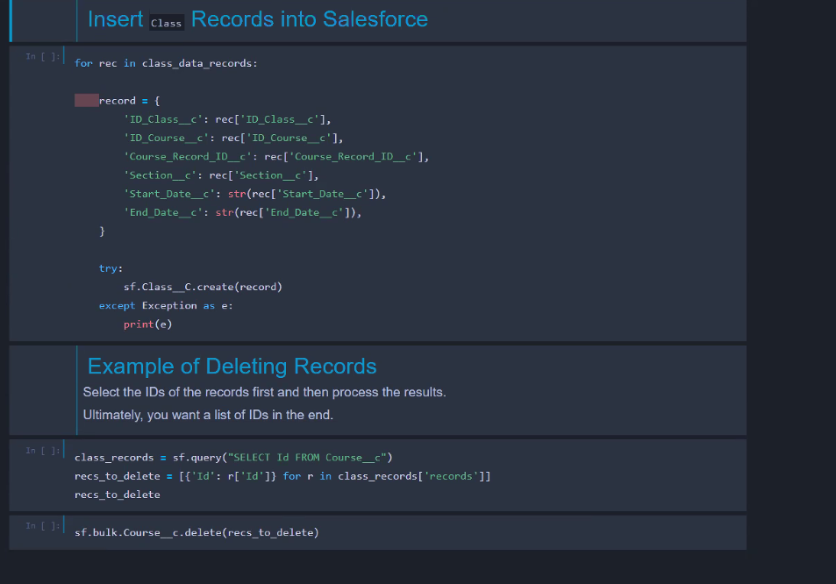

Slide 10
